Slide 1
Contemporary Drawings

Slide 2
Anna Sigmond Gudmundsdottir

Slide 3
Anna Sigmond Gudmundsdottir

Slide 4
Anna Sigmond Gudmundsdottir

Slide 5
Jesse Bransford Mural Installation

Slide 6
Dominic McGill

Slide 7
Dominic McGill

Slide 8
Jane Hammond

Slide 9
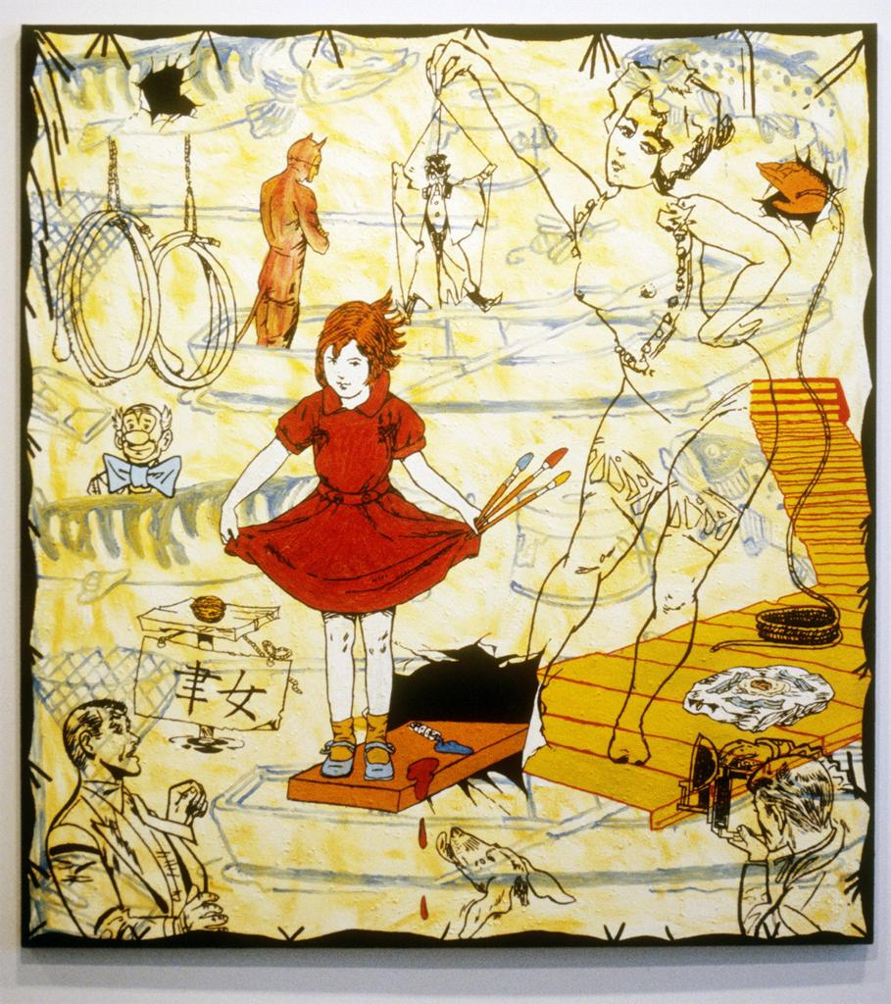
Jane Hammond

Slide 10
Jane Hammond

Slide 11
Jane Hammond

Slide 12
Carroll Dunham, Pine Gap

Slide 13
Carol Dunham

Slide 14
Keith Tyson The Seven Wonders

Slide 15
Julie Mehretu

Slide 16
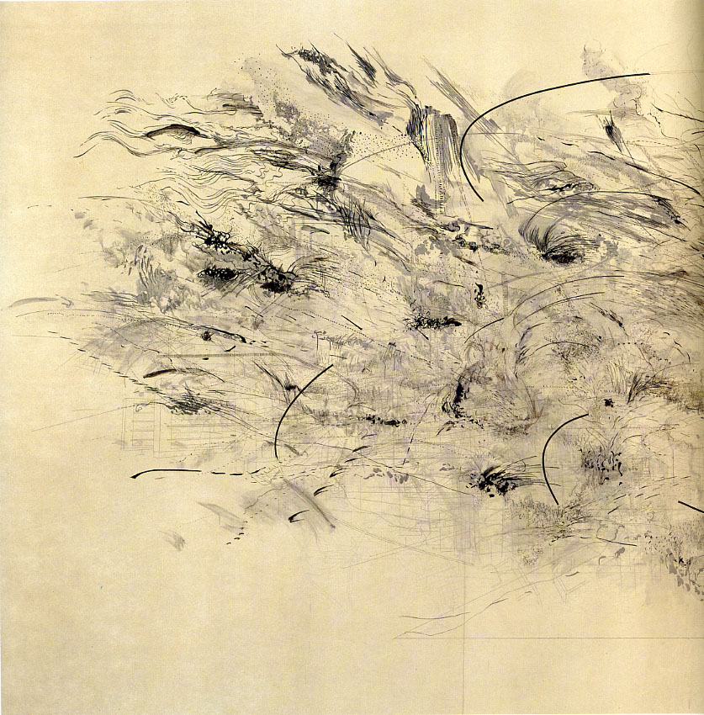
Julie Mehretu

Slide 17
Kertin Kartscher

Slide 18
Ernesto Caivano

Slide 19
Glexis Novoa Cityscape

Slide 20
Glexis Novoa

Slide 21
Glexis Novoa

Slide 22
Collaborative Drawing

Slide 23
Appleton Primary School

Slide 24
Dr. Lakra Heads

Slide 25
Dr. Lakra Heads

Slide 26
Sidney Goodman, Burning

Slide 27
Sidney Goodman

Slide 28
http://davidleigh.4ormat.com/

Slide 29
http://www.usaprojects.org/user/michaelhouston

Slide 30
http://davidcastillogallery.com/kate-gilmore-rock-hard-place/

